Slide 1
Simple
Tip Calculator
Student ID：202239627
YUAN HAOCHENG

Slide 2
CONTENTS
01
02
Requirement Analysis
System
Design
03
04
Results
Test
Code

Slide 3
PART ONE
01
Requirement Analysis

Slide 4


Get requirements
Goal: Help users easily calculate the total bill including
tip.
Functional requirements
Who will use it?
result
Enter the bill amount and tip percentage to calculate the total amount
Employees and customers checking out in restaurants, cafes, etc.
Input: bill amount, percentage
Output: Tip amount, total bill amount

Slide 5
PART TWO
02
System
Design

Slide 6


System Design
Function
Input module (input bill and tip percentage)
Calculation module (tip = bill × percent / 100, total = bill + tip)
Output module (display tip and total amount)
User input
calculate tip
display tip & total

Slide 7
PART THREE
03
Code

Slide 8
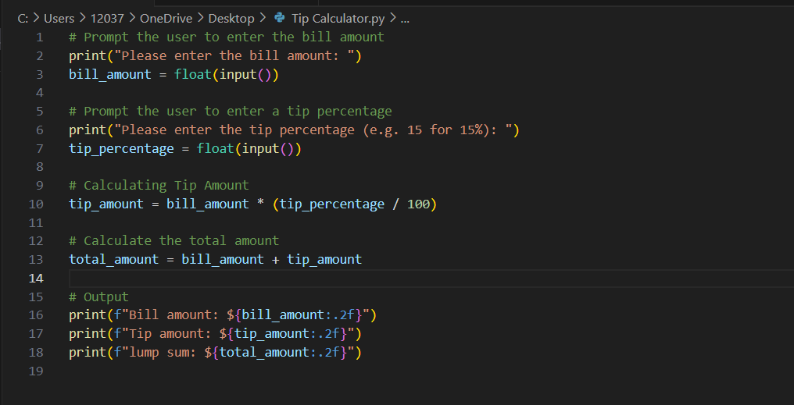
Code

Slide 9
PART FOUR
04
Results
Test

Slide 10
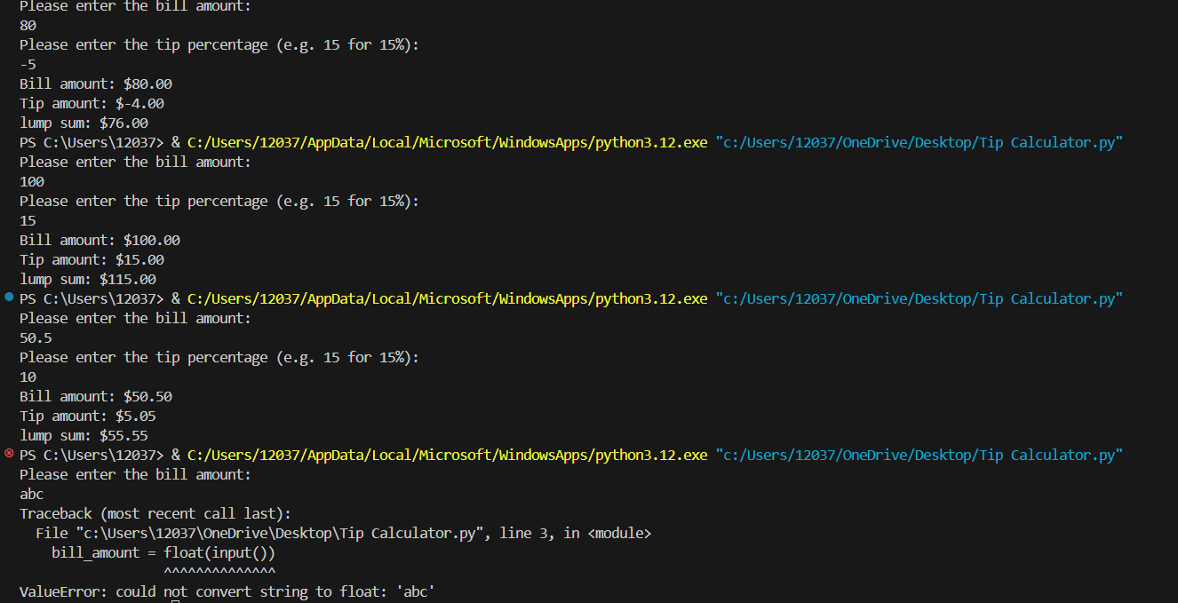
Results Test
Output
Case 1 | 80 | -5 | -4 | 76
Case 1 | 100 | 15 | 15.00 | 115.00
Case 2 | 50.5 | 10 | 5.05 | 55.55
Case 3 | abc | 10 | Input error prompt | -

Slide 11
THANKS
Q＆A
Github:
https://github.com/sgyhczbsn/Simple-Tip-Calculator

